Slide 1
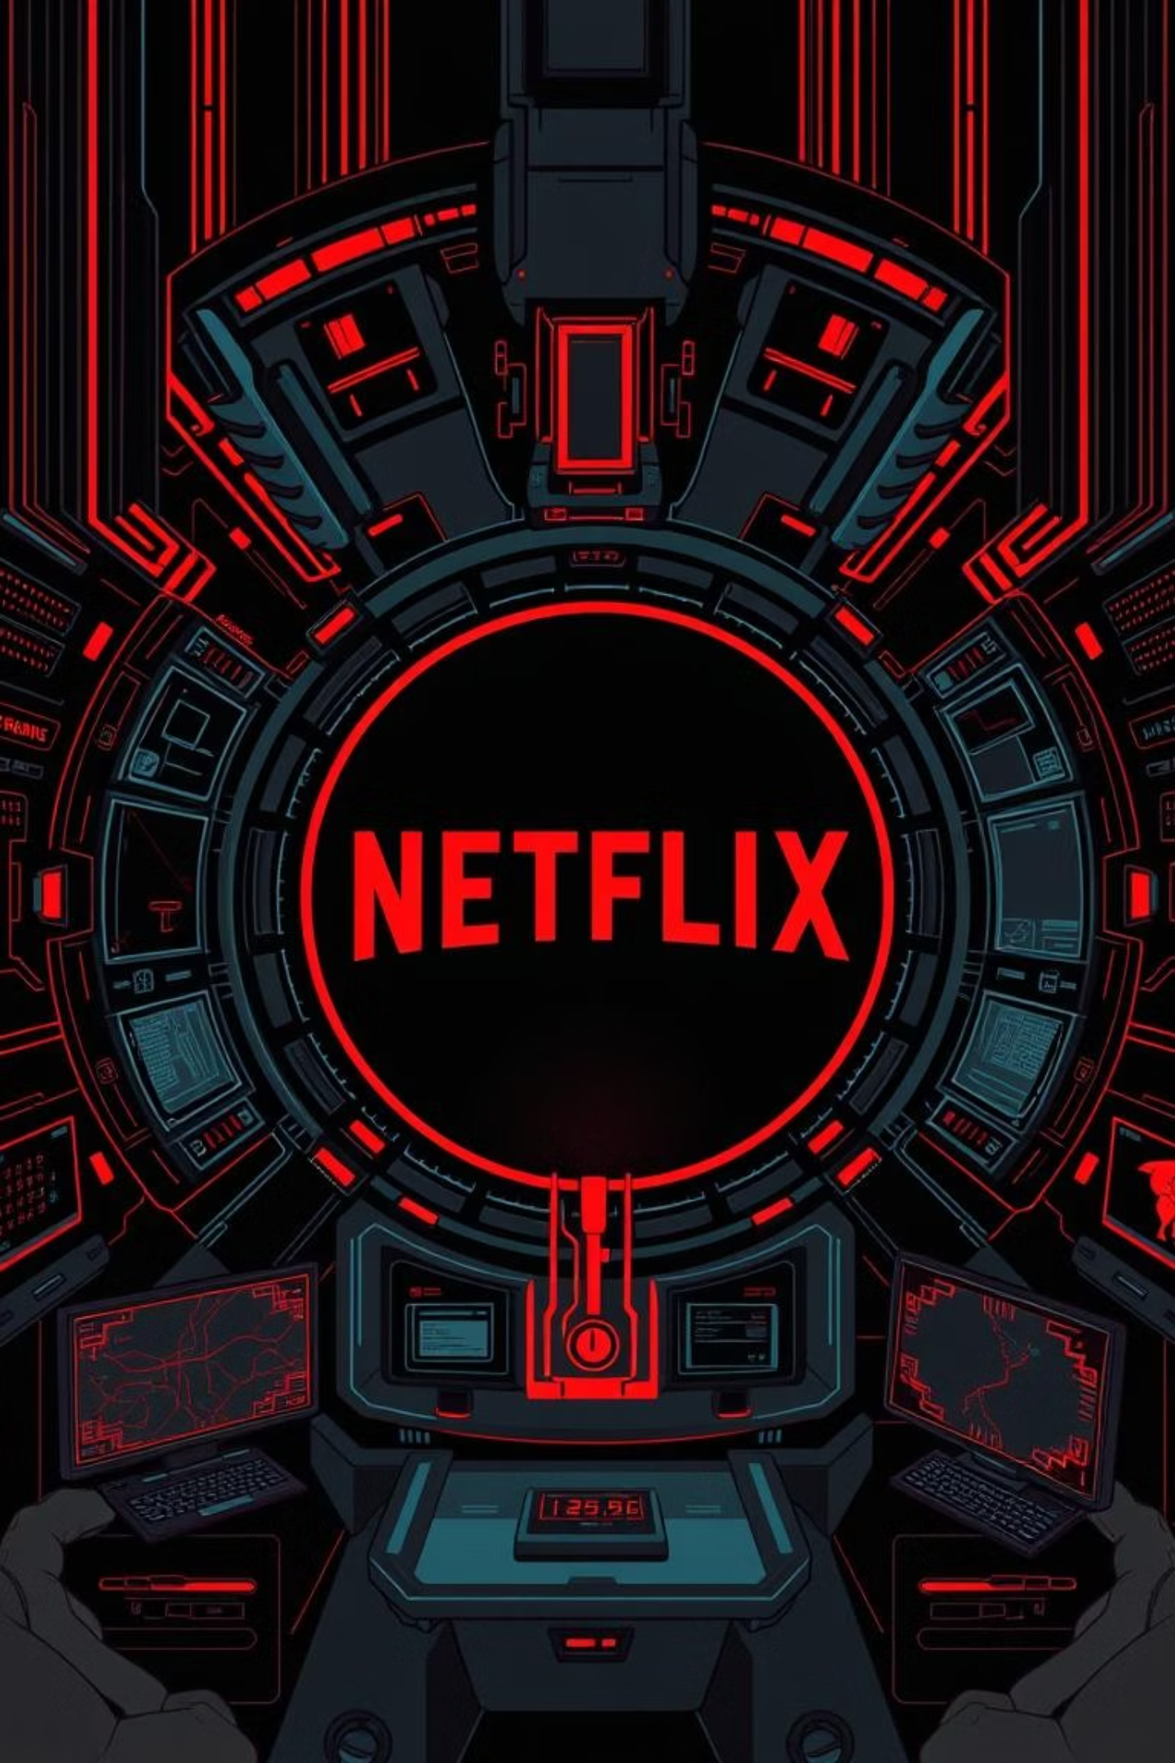
Unlocking Netflix's Next Era: A Product Teardown
~BY ABHINAV BHARDWAJ
Welcome to an in-depth product teardown of Netflix, where we explore its current landscape and envision its future. Our goal is to identify key areas for innovation that enhance user experience and drive significant business value, assuming unlimited technological capabilities.

Slide 2



Chapter 1: Strategic Foundations
Deconstructing Netflix's Business Model & Outcomes
Subscription Revenue Focus
Driving Product Outcomes
Content & Value Proposition
Netflix primarily operates on a subscription-based model (SVOD), offering ad-free tiers, an ad-supported tier, and supplementary revenue from DVD rentals in some regions. This model drives predictable recurring revenue.
Business outcomes like increased subscriber growth, reduced churn, and higher Average Revenue Per User (ARPU) directly map to product outcomes such as enhanced content discovery, improved engagement, and seamless user experience.
The core value proposition lies in exclusive original content, a vast library of licensed titles, and personalized recommendations, aiming to maximize watch time and perceived value for subscribers.

Slide 3

Chapter 2: User-Centric Problem Solving
Identifying Unmet Needs Through User Research
Target User Segment
Our primary target audience includes global entertainment consumers, ranging from casual viewers to avid cinephiles, across diverse demographics who seek convenient, high-quality, and personalized content experiences.
Validating User Problems
Through extensive surveys, interviews, and A/B testing, we've identified key pain points: "decision paralysis" due to content overload, difficulty finding specific niche content, and a desire for more interactive viewing experiences.

Slide 4
Analyzing & Breaking Down Core Problems
Content Discovery Fatigue
Passive Consumption
Monetization & Engagement Gap
Users spend excessive time browsing rather than watching. This often stems from an overwhelming volume of options, generic recommendations, and the lack of intuitive filters for specific moods or niche interests.
Current viewing is largely passive. Users express a desire for more engaging experiences, such as interactive storytelling, community features, or deeper dives into content backstories, moving beyond linear playback.
While ad-supported tiers exist, there's untapped potential for new monetization avenues that enhance user value without disrupting the core experience, like premium interactive features or exclusive content access.

Slide 5










Chapter 3: Ideation & Solutioning
Introducing "Netflix Immersive Worlds"
Our proposed solution, "Netflix Immersive Worlds," tackles content discovery fatigue and passive consumption head-on by transforming the browsing experience into an interactive journey. It also opens new monetization opportunities.
Social & Community Layers
Interactive Content Hubs
In-world avatars, watch parties, and shared discovery pathways with friends.
Genre-specific "worlds" (e.g., a "Sci-Fi Nexus" or "Fantasy Realm") where users navigate visually to discover content.
AI-Driven Personalization
Recommendations integrated into the world's environment, guiding users to relevant content based on mood and past interactions.
Gamified Discovery
Small quests or challenges within worlds that lead to new content or behind-the-scenes material.
Premium Access Zones
Exclusive areas within worlds for premium subscribers, offering early access or bonus features, driving ARPU.

Slide 6
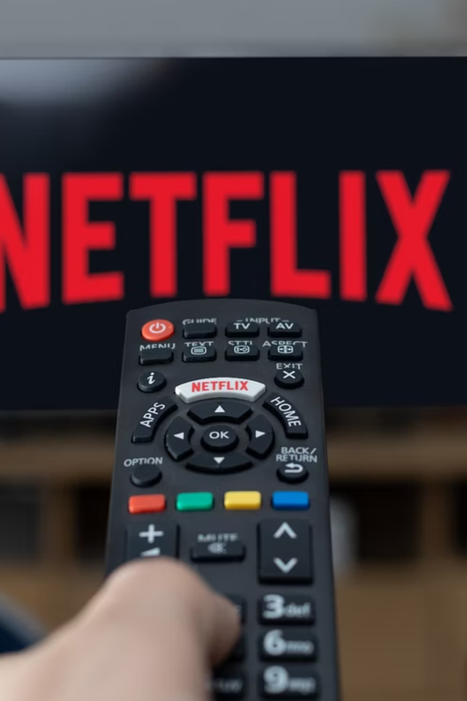
Proposed Solution: System Diagram & Actors
The "Netflix Immersive Worlds" system involves several key actors and interconnected components to deliver its innovative experience.
Key Actors:
User:
Content Discovery Engine: Powers dynamic content loading and contextual recommendations within each world.
Social Interaction Module: Facilitates multi-user presence, chat, and shared experiences.
AI Recommendation System: Learns user preferences and dynamically adjusts world elements and content suggestions.
Backend Content Management: Integrates content metadata, interactive elements, and premium access rules.

Slide 7
Chapter 4: Anticipating & Measuring Success
Second-Order Thinking & Success Metrics
25%
10%
5%
Increased Engagement
Reduced Churn
ARPU Growth
Aim for a 25% increase in average session duration and a 15% rise in unique content titles viewed per user within the immersive worlds.
Target a 10% reduction in churn rate for users actively engaging with Immersive Worlds, reflecting increased stickiness.
Anticipate a 5% growth in Average Revenue Per User (ARPU) driven by premium feature adoption and increased subscription tier upgrades.
Second-Order Thinking:
Potential Overwhelm:
Content Bias: The immersive design might inadvertently favor certain content types over others. Continuous A/B testing and user feedback will ensure equitable content visibility.
Technical Scalability: Even with infinite bandwidth, optimizing immersive rendering for diverse devices will be crucial to ensure a smooth, equitable experience for all users.

Slide 8
Chapter 5: Risk Assessment
Mitigating Potential Failure Points
Why Netflix Immersive Worlds Might Fail
While ambitious, "Netflix Immersive Worlds" faces several risks:
User Adoption Hesitancy: Users might prefer traditional interfaces, finding the immersive experience too complex or unnecessary. Mitigation: Offer gradual onboarding and make the immersive mode optional, with clear benefits.
Content Integration Challenges: Adapting existing content for immersive discovery requires significant metadata enrichment and new categorization, potentially leading to incomplete experiences. Mitigation: Prioritize new content for full immersive integration and progressively enhance the back catalog.
Technical Debt & Maintenance: Building and maintaining complex immersive environments can create substantial technical debt. Mitigation: Implement modular architecture and robust automated testing, ensuring continuous integration and deployment with dedicated teams.
Monetization Misfire: If premium features within worlds don't resonate, the ARPU growth target may not be met. Mitigation: Conduct extensive user testing on pricing and feature bundles, iterating quickly based on early adoption data.

